Slide 1

Hotel Bookind Demand
Machine Learning Project
Martelli Giorgio
Testa Luca

Slide 2

Agenda
Introduction
Dataset
EDA
Model
Conclusions

Slide 3

Introduction
Have you ever wondered when the best time of year to book a hotel room is? Or the optimal length of stay in order to get the best daily rate? What if you wanted to predict whether or not a hotel was likely to receive a disproportionately high number of special requests? With this dataset we would like to try to predict a cancellation based on data.

Slide 4


Dataset
The datasets now made available were collected aiming at the development of prediction models to classify a hotel booking’s likelihood to be canceled. These are 3 variables of 32:
adr: Average Daily Rate
Meal: Undefined/SC – no meal package; BB – Bed & Breakfast; HB – Half board (breakfast and one other meal – usually dinner); FB – Full board (breakfast, lunch and dinner)
Cancelled: Target Variable

Slide 5

EDA
Data Profiling

Slide 6
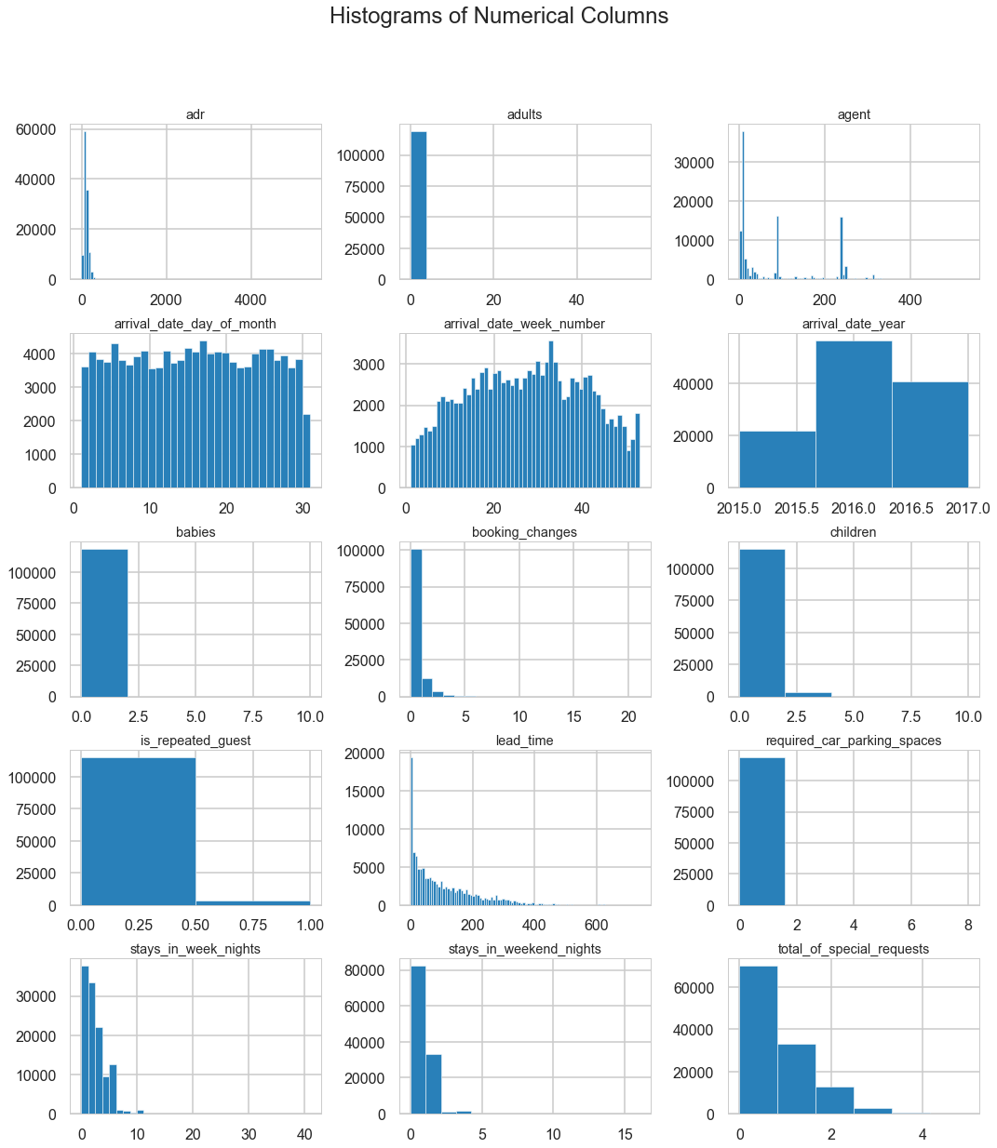
Numeric Variable Distribution
Here we’ve the cancellation rate of all the dataset. It can be understood that there are a lot of uncanceled booking and that, maybe, we will have to balance the target class.

Slide 7
Numeric Variable Distribution
Here we’ve the cancellation rate of all the dataset. It can be understood that there are a lot of uncanceled booking and that, maybe, we will have to balance the target class.

Slide 8
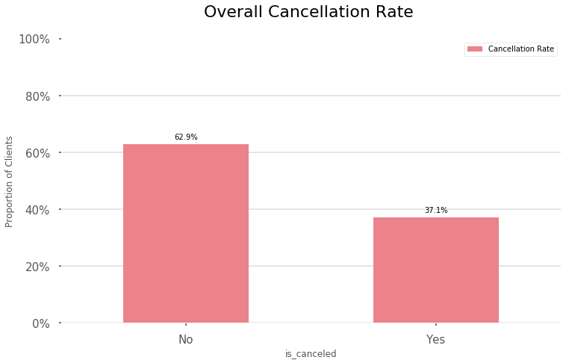
Cancellation Rate Distribution
Here we’ve the cancellation rate of all the dataset. It can be understood that there are a lot of uncanceled booking and that, maybe, we will have to balance the target class.
We decided to balance the classes.

Slide 9
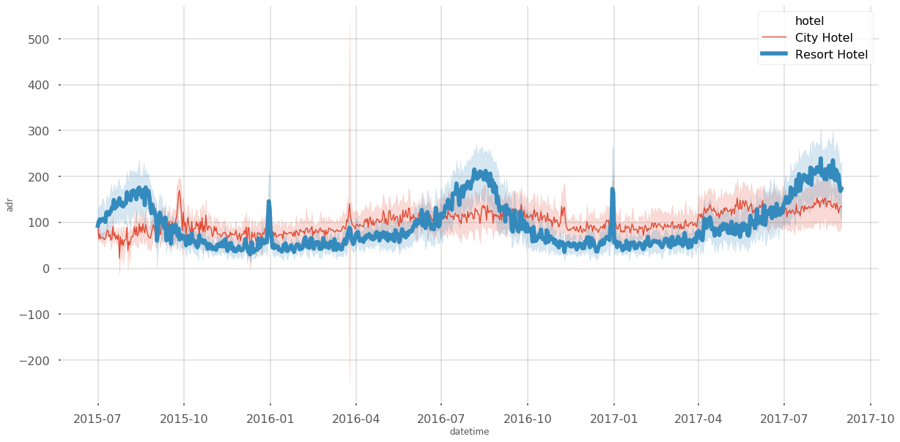
Datetime Hotel Distribution
We can see the differences, by date, of the price per night for the two types of structures in the dataset.

Slide 10
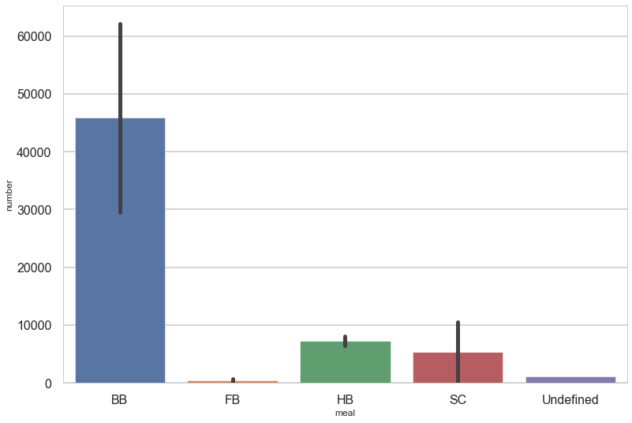
Different Type of Treatment
Here we have the number of bookings divided by type of treatment.
BB: Bed and Breakfast
FB: Full Board
HB: Half Board
SC: No Meal

Slide 11
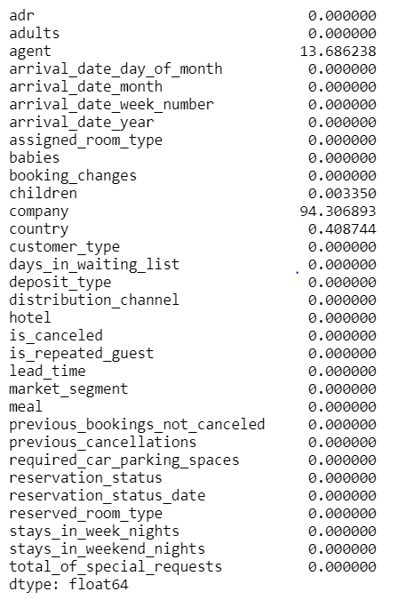
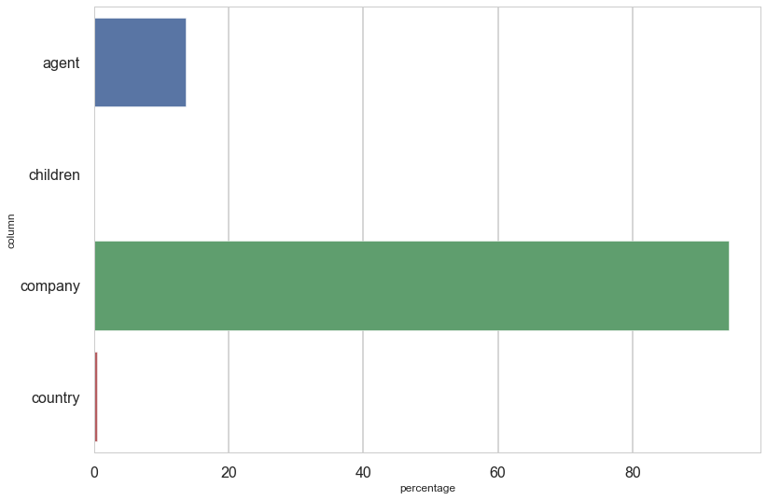
Percentage of NaN Values
For the variable with 94% missing values, ​​it was decided to delete it. For the other two variables it was decided to replace the missing values ​​with the average of the data trend.

Slide 12
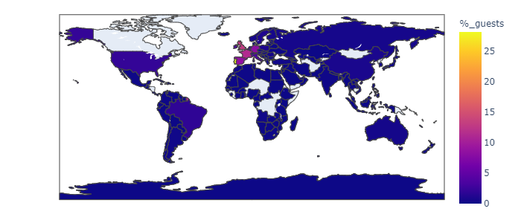
Map of % guests
The majority of the guests come from Europe but there are a lot of country in this dataset.

Slide 13
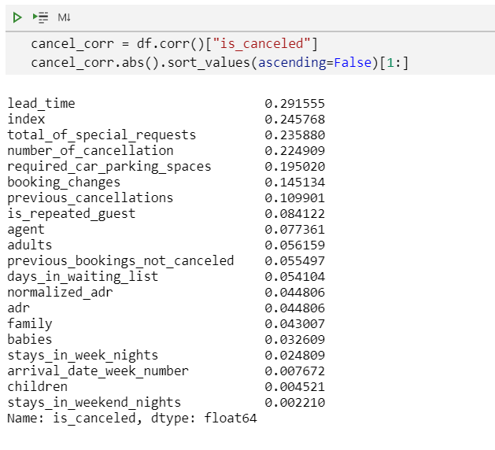
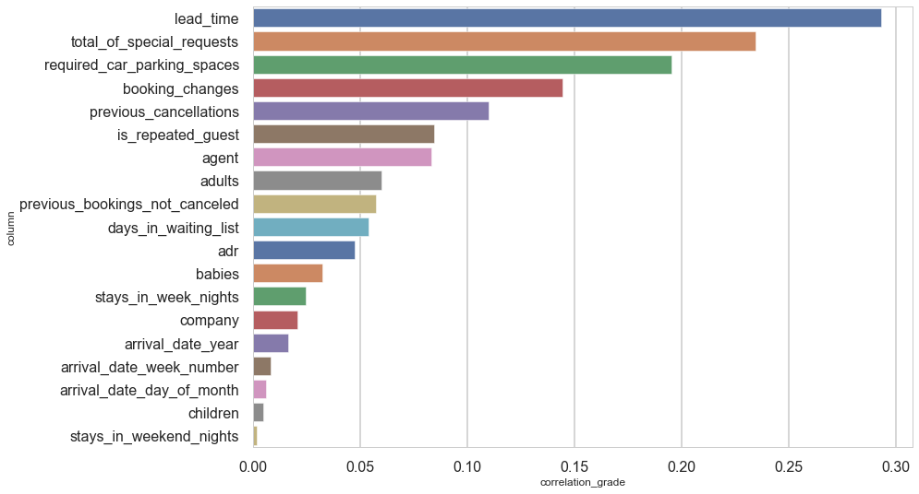
Variables Correlated With Our Target

Slide 14
Model Explanation
We decided to use 4 basic models (without parameters) in order to evaluate the best on the basis of accuracy and time. Best model is XTremeGradient Boosting, based on the accuracy and the run time
Classifiers | Accuracy | Time
Decision Tree | 0,84 | 1 sec
Random Forest | 0,87 | 12 sec
Xtreme Gradient Boosting | 0,86 | 4 sec
Light Gradient Boosting | 0,85 | 1 sec

Slide 15
Model Explanation: XGB
T1
T2
T3
T4
We use XGB without parameters.
Accuracy: 0,86
Run Time: 4 sec
Then we’ve implemented 5 Cross Validations.
Accuracy: 0,87
Run Time: 105 sec
Then we’ve implemented a GridSearch, best estimators:
N_estimators (190)
Learning_rate (0,1)
Max_depth (12)
Accuracy: 0,89
Run Time: 13 sec
Then we’ve mixed CV and GridSearch Parameters:
Accuracy: 0,89
Run Time: 2 sec

Slide 16
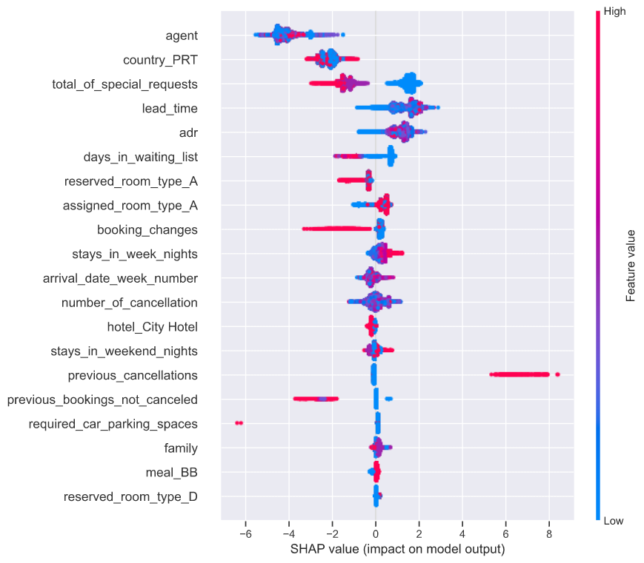
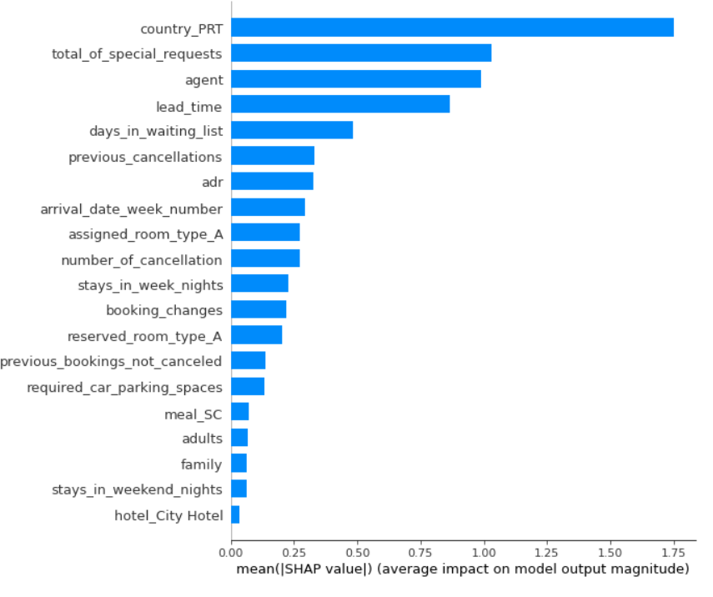
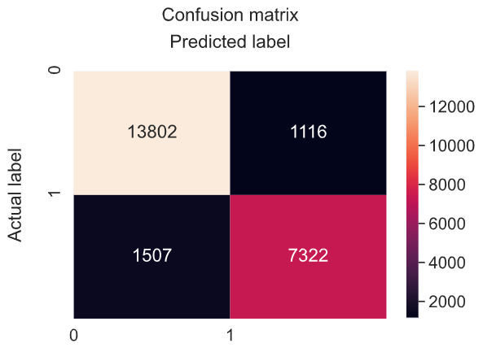
Model Explanation: XGB
Confusion Matrix tell us how the model is able to predict data never seen before, an accuracy of 90% is achieved. Shap, otherwise, makes us understand which variables are the most significant.

Slide 17

In conclusion, we can say that, as future developments, it would be interesting to test neural networks to try to improve the classification. Furthermore, the dataset could be extended by collecting data in real time in order to improve the capabilities of classifiers.
Conclusions

